Slide 1

Introduction to Agentic AI

Slide 2
Agenda – Day 1
1
AI journey
Rule-based → ML → Deep Learning → Generative AI
2
From chatbots to autonomous agents
How LLMs evolved into goal-driven AI agents
3
Limitations of GenAI
Why prompting alone is not enough
4
AI agent architectures
Reactive, Deliberative and Hybrid designs

Slide 3
Generative AI
A subset of Artificial Intelligence (AI)
Enables machines to generate new, original content
Uses machine learning algorithms to create novel outputs
Can generate text, images, music, and more
Trained on large datasets to learn patterns and relationships
Notes:
it's a type of AI that enables machines to generate new, original content. This can be anything from text to images to music, and it's all made possible by machine learning algorithms and large datasets

Slide 4
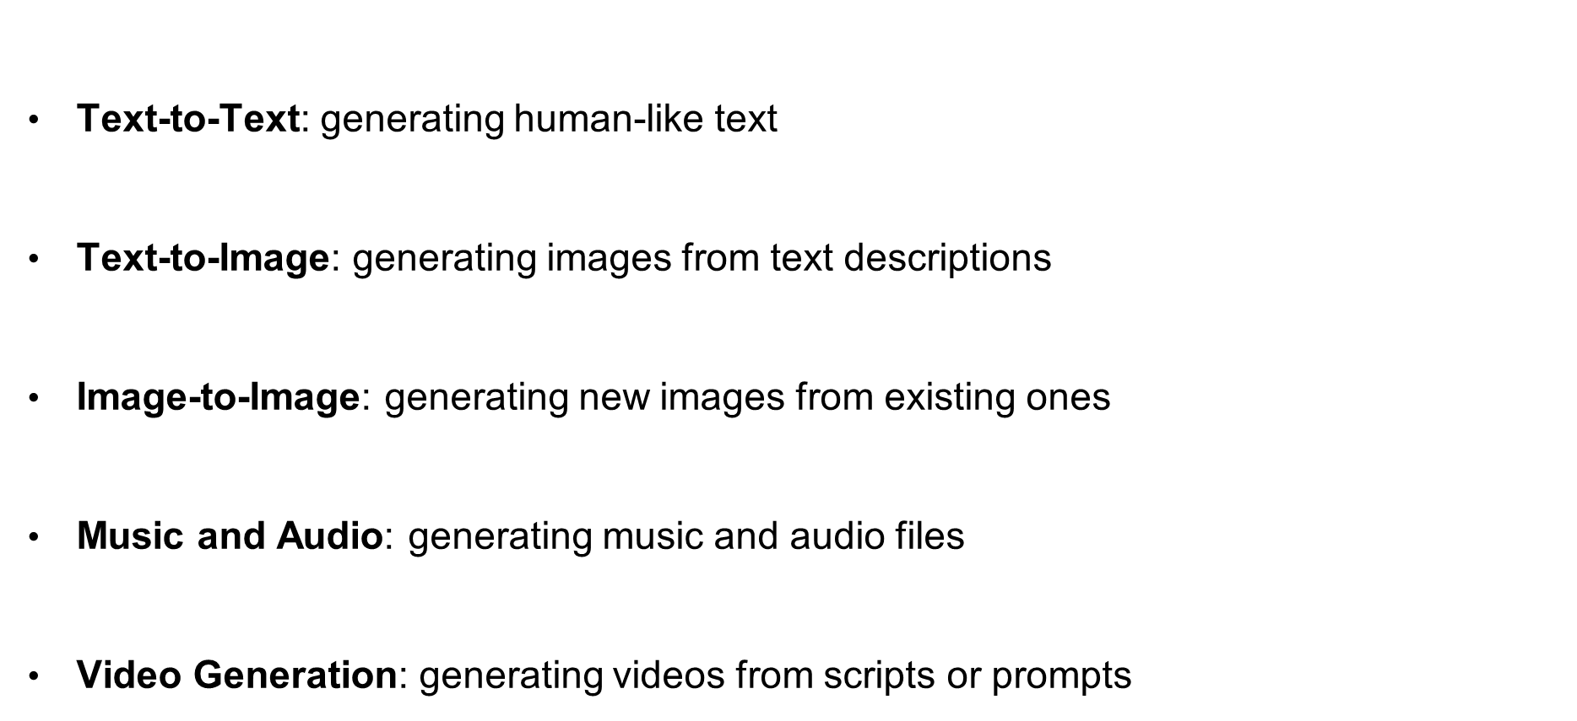
Types of GenAI
Text-to-Text: generating human-like text
Text-to-Image: generating images from text descriptions
Image-to-Image: generating new images from existing ones
Music and Audio: generating music and audio files
Video Generation: generating videos from scripts or prompts
Notes:
From generating human-like text to creating new images and music, the possibilities are endless. Each type of GenAI has its own unique applications and use cases.

Slide 5
Limitations of GenAI
It generates responses based on prompts but doesn't autonomously pursue long-term objectives or complete tasks without continuous prompting.
Generative models usually lack persistent memory across sessions.
Generative AI struggles with multi-step reasoning or breaking down complex tasks
Generative AI doesn’t interact with external tools or systems (APIs, databases, web browsers) unless explicitly connected.
ChatGPT or other LLMs just respond to prompts — no looped execution or self-initiated action.
Generative AI is a single-agent model, not designed for coordination between multiple AI entities.
LLMs may hallucinate but don’t typically verify or improve their answers over time.

Slide 6

AI Agents
AI agent is an autonomous entity capable of perceiving its environment, making decisions, and taking actions to achieve specific goals. Agents can vary in complexity from simple reactive agents that respond to stimuli to more advanced intelligent agents that learn and adapt over time.
Types of agents include:
Reactive Agents: Respond directly to environmental changes without internal memory.
Model-Based Agents: Use internal models of the world to make decisions.
Goal-Based Agents: Plan actions based on achieving specific goals.
Utility-Based Agents: Evaluate potential actions based on a utility function to maximize outcomes.

Slide 7
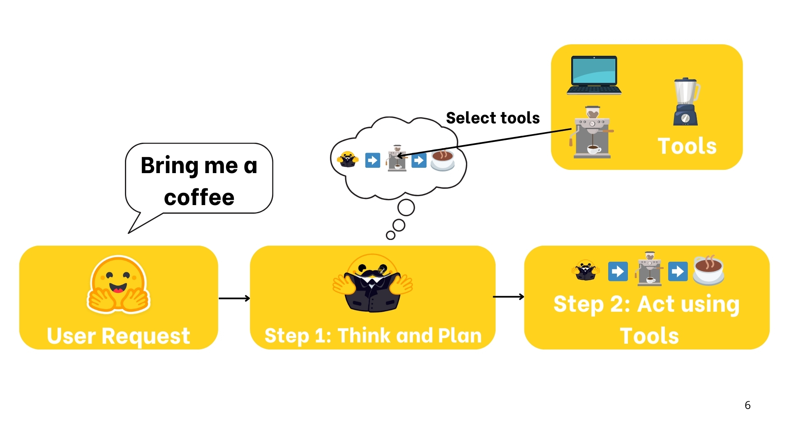
What is an AI Agent?

Slide 8
How an AI Agent Works
An AI agent takes a goal, thinks and plans, uses tools to act, checks the result, and repeats until the goal is done.
Plan
1. Search flights
2. Compare fares
3. Book best option
4. Send confirmation
Tools
“Book me a flight to Delhi on Friday morning”
Flight search API
Calendar
select
Payment API
Email
User Request
The goal, in plain language
Step 1: Think & Plan
LLM reasons and breaks the goal into steps
Step 2: Act using Tools
Calls APIs to search, compare and book
Step 3: Observe & Respond
Checks results, then confirms: “Booked 6E-512, 9:05 AM”
Not done yet (e.g. flight sold out)? Observe → re-plan → act again
AI Agent = LLM (brain) + Planning + Tools + Memory, working in a loop until the goal is met

Slide 9
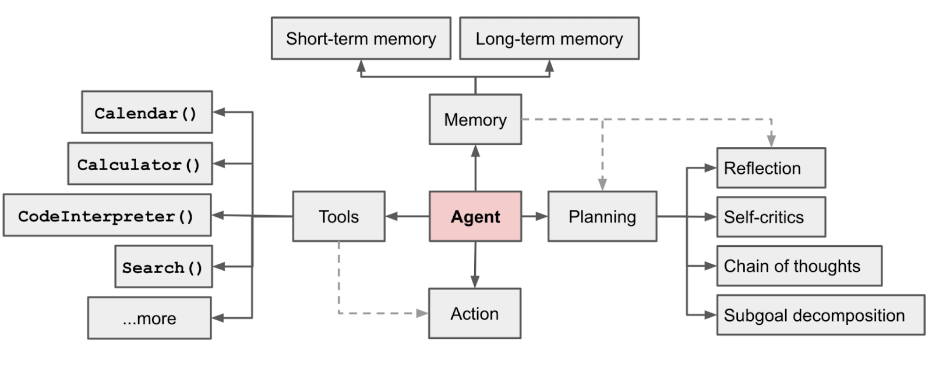
LLM Agent Components
Source: https://lilianweng.github.io/posts/2023-06-23-agent/

Slide 10
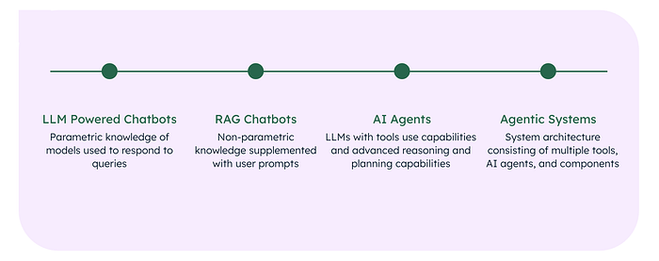
From LLMs to AI Agents
1.1 Traditional chatbots to LLM-powered chatbots
Heuristic-Based Responses:
Traditional chatbots operated on rule-based logic (“if-then” statements).
Limited to predefined rules and unable to manage complex or ambiguous queries.
Canned Responses:
Responses were static and predefined.
Triggered by detecting specific keywords or phrases.
Lacked flexibility and conversational depth.
Human Handoff:
Always included a “Speak to a human” button for unresolved queries.
Human intervention remained essential for handling complex issues.

Slide 11
From LLMs to AI Agents (contd.)
1.2 Introduction of LLM-Powered Chatbots
Launch of ChatGPT: On November 30, 2022, OpenAI introduced ChatGPT, powered by GPT-3.5, as the first mainstream LLM application. ChatGPT retained the familiar chatbot interface but was backed by advanced LLM technology trained on a vast internet corpus.
Limitations:
Personalization: Struggles to maintain consistent, personalized interactions over long conversations.
Hallucinations: Can produce factually incorrect but coherent responses, generating outputs based on probabilities rather than verified knowledge.
1.3 From LLM-Powered Chatbots to RAG Chatbots and AI Agents
RAG Chatbots: Retrieval-Augmented Generation (RAG) combines external data retrieval with LLM capabilities to produce accurate and contextually grounded responses.
Sources of Knowledge:
Non-Parametric Knowledge: Real-time data retrieved from external sources like the internet or proprietary databases.
Parametric Knowledge: Embedded knowledge within the LLM from its training.

Slide 12

Key Characteristics of AI Agent
1
Goal-Oriented
2
Autonomous
AI Agent systems are designed with specific goals in mind, driving their actions and decisions.
They can operate independently, making decisions and taking actions without constant human intervention.
3
Self-Learning
4
Contextual Awareness
AI Agent continuously learns and improves its performance based on data and feedback.
They can understand and adapt to changing contexts, making decisions based on real-time information.

Slide 13
AI Agent Architectures
Reactive • Deliberative • Hybrid
How an agent connects what it perceives to what it does

Slide 14
AI Agent Architectures – Overview
An agent architecture defines how perception is turned into action — react instantly, reason first, or combine both.
Reactive
Sense → Act

Slide 15
Reactive Architecture
“Don’t think, just respond” — behaviour is triggered directly by what the agent senses right now.
Key characteristics
Sensors
perceive current state
Condition–Action Rules
IF … THEN …
Actuators
execute action
Maps the current percept directly to an action using condition–action rules
Keeps no world model and no memory of past states
Complex behaviour emerges from simple layered behaviours (Brooks’ Subsumption Architecture, 1986)
percepts
actions
Pros
Real-time response
Simple to build & test
Robust to noise
Cons
Cannot plan ahead
No learning from history
Can loop or get stuck
Environment
network, user, physical world
No internal state • No planning • Stimulus → response
Telecom example Alarm handler: IF link_down on a cell site THEN reroute traffic and raise a ticket — in milliseconds, no reasoning.

Slide 16
Deliberative Architecture
“Think before you act” — the agent builds a model of its world, reasons about goals, then commits to a plan.
Perceive
gather observations
World Model
beliefs about the state
Deliberate
goals → intentions
Plan
search an action sequence
Execute
carry out the plan
environment changes → re-perceive and re-plan
Key characteristics
Explicit, symbolic internal model of the world
Searches for a plan to reach goals before acting
Classic models: BDI (Beliefs–Desires–Intentions), STRIPS planners
Pros / Cons
+ Goal-directed, near-optimal decisions
+ Explainable, auditable plans
+ Handles complex multi-step tasks
– Slow: must think before acting
– Compute-heavy reasoning
– Model goes stale in fast-changing settings
Telecom & AI examples
Capacity planning agent: forecasts traffic, compares options (add carrier, re-tilt, rebalance), outputs a rollout plan
LLM plan-and-execute agents that draft a step list before calling tools

Slide 17
Hybrid Architecture
“Plan strategically, react instantly” — reflexes for speed, planning for foresight.
Sensors
Deliberative layer
goals • world model • long-term planning
Actuators
How it works
Reactive layer handles urgent events immediately
Deliberative layer sets goals and long-horizon plans
Executive layer arbitrates between them and re-plans when reflexes fire
Executive / sequencing layer
selects behaviours • monitors plan progress
Self-driving car
Route planning + emergency-brake reflex
Reactive layer
reflexes • safety rules • real-time control
Autonomous network
Closed-loop self-healing + RAN/energy optimisation
Known designs: 3T (three-tier), InteRRaP, TouringMachines
LLM agents (ReAct)
LLM reasons & plans; tools and guardrails react

Slide 18
Reactive vs Deliberative vs Hybrid
Dimension | Reactive | Deliberative | Hybrid
Decision basis | Current percepts (IF–THEN rules) | World model + goals | Reflexes + plans
Memory / state | None | Rich internal model | Layered state
Response speed | Very fast | Slow | Fast reflexes, slower plans
Planning | None | Full look-ahead | At the top layer
Adaptability | Low — fixed rules | Medium — re-plans | High
Design complexity | Low | High | Highest
Best suited for | Real-time, predictable tasks | Complex, stable environments | Dynamic real-world systems
Telecom example | Alarm auto-remediation | Capacity / RAN planning | Self-healing autonomous network
Takeaway Most modern LLM agents are hybrid: the LLM deliberates (reasons, plans), while tools, rules and guardrails give fast, reactive behaviour.

Slide 19

Use Cases
Customer Service Automated chatbots handling initial customer inquiries
Virtual assistants providing 24/7 support
AI agents resolving common issues without human intervention
Personal Productivity Digital assistants managing calendars and scheduling
Email sorting and prioritization agents
Task management systems with intelligent recommendations
Healthcare Diagnostic support agents analyzing patient symptoms
Medication management assistants for patients
Administrative agents handling appointment scheduling and records
Financial Services Robo-advisors managing investment portfolios
Fraud detection agents monitoring transactions
Insurance claim processing automation

Slide 20
Use Cases (contd.)
Sales and Marketing Lead qualification and scoring agents
Personalized product recommendation engines
Marketing automation tools optimizing campaigns
Manufacturing and Supply Chain Predictive maintenance agents monitoring equipment
Inventory optimization systems
Quality control agents detecting defects
Education Tutoring agents providing personalized learning
Grading assistants evaluating assignments
Course recommendation agents suggesting appropriate classes
Home Automation Smart home assistants controlling devices and systems
Security monitoring agents detecting unusual activity
Energy optimization agents managing consumption

Slide 21
When to Use an AI Agent
Task: You want to build a system that automatically collects product reviews from competitor websites, analyzes sentiment, extracts feature requests, and emails a summary to the product team every Monday.
Solution Using an AI Agent
An AI Agent is a good fit because the task is:
    Goal-driven: "Get weekly insights from competitor reviews"
Multi-step: Browse → Scrape → Analyze → Summarize → Email
    Tool-based: Needs access to browser tools, NLP libraries, and email API
  Autonomous: Should run weekly without manual intervention
Example Workflow for the Agent:
Web Scraper Tool: Extracts latest reviews from competitor websites.
Sentiment Analyzer (NLP pipeline): Analyzes each review.
LLM Tool: Extracts key themes, complaints, and feature requests.
Summarizer: Generates a weekly insights report.
Email Tool: Sends the report to a Slack channel or email inbox.
Agent Advantages:
Can adapt if some pages fail or URLs change.
Can log errors and retry steps.
Can evolve over time with feedback and memory.

Slide 22
When Not to Use an AI Agent
If the task was simpler, like: "Summarize a block of text and send it via email",
a Generative AI prompt + API script would be more efficient. You can:
Paste the reviews manually.
Use a single GPT prompt to summarize them.
Trigger an email function.
🛑 Why Not an Agent?
No need for autonomy or adaptive planning.
Simpler, faster, and cheaper to do in one shot.
Easier to debug and deploy.

Slide 23
Build An Agent

Slide 24
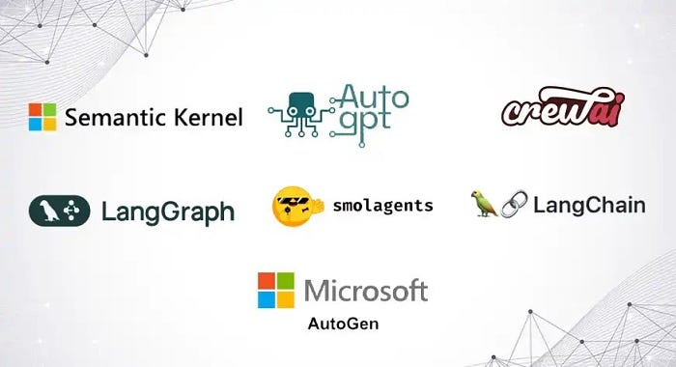
Agentic Framework

Slide 25




Frameworks
Framework | Language | Description | Best For
LangGraph | Python, Javascript | A graph-based framework built on top of LangChain, designed to coordinate multiple agents and tools with memory. | Structured agent workflows with LLMs.
CrewAI | Python | Simple and intuitive agent orchestration framework for teams of LLM agents. Uses a “Crew” and “Agent” model with roles and goals. | Task-oriented multi-agent collaboration.
AutoGen | Python | Microsoft’s framework for building LLM-powered agents that communicate via messaging. Supports human-AI and AI-AI collaboration. | Multi-agent chat and complex interactions.
AgentVerse | Python | Designed for simulating and evaluating large numbers of agents. Ideal for research on collective behaviors. | Multi-agent simulations and social dynamics.
OpenAgents | Python | Open-source project combining LangChain, FastAPI, and other tools. Allows UI integration and multi-agent task execution. | Developer-friendly agent apps.
MiniAGI | Python | Lightweight framework for building LLM-based agents using memory, tools, and recursive reasoning. | Quick experimentation with agents.
MetaGPT | Python | Treats AI agents like team members in a software company (e.g., PM, engineer, QA). Modular and production-oriented. | Building software with agent teams.

Slide 26
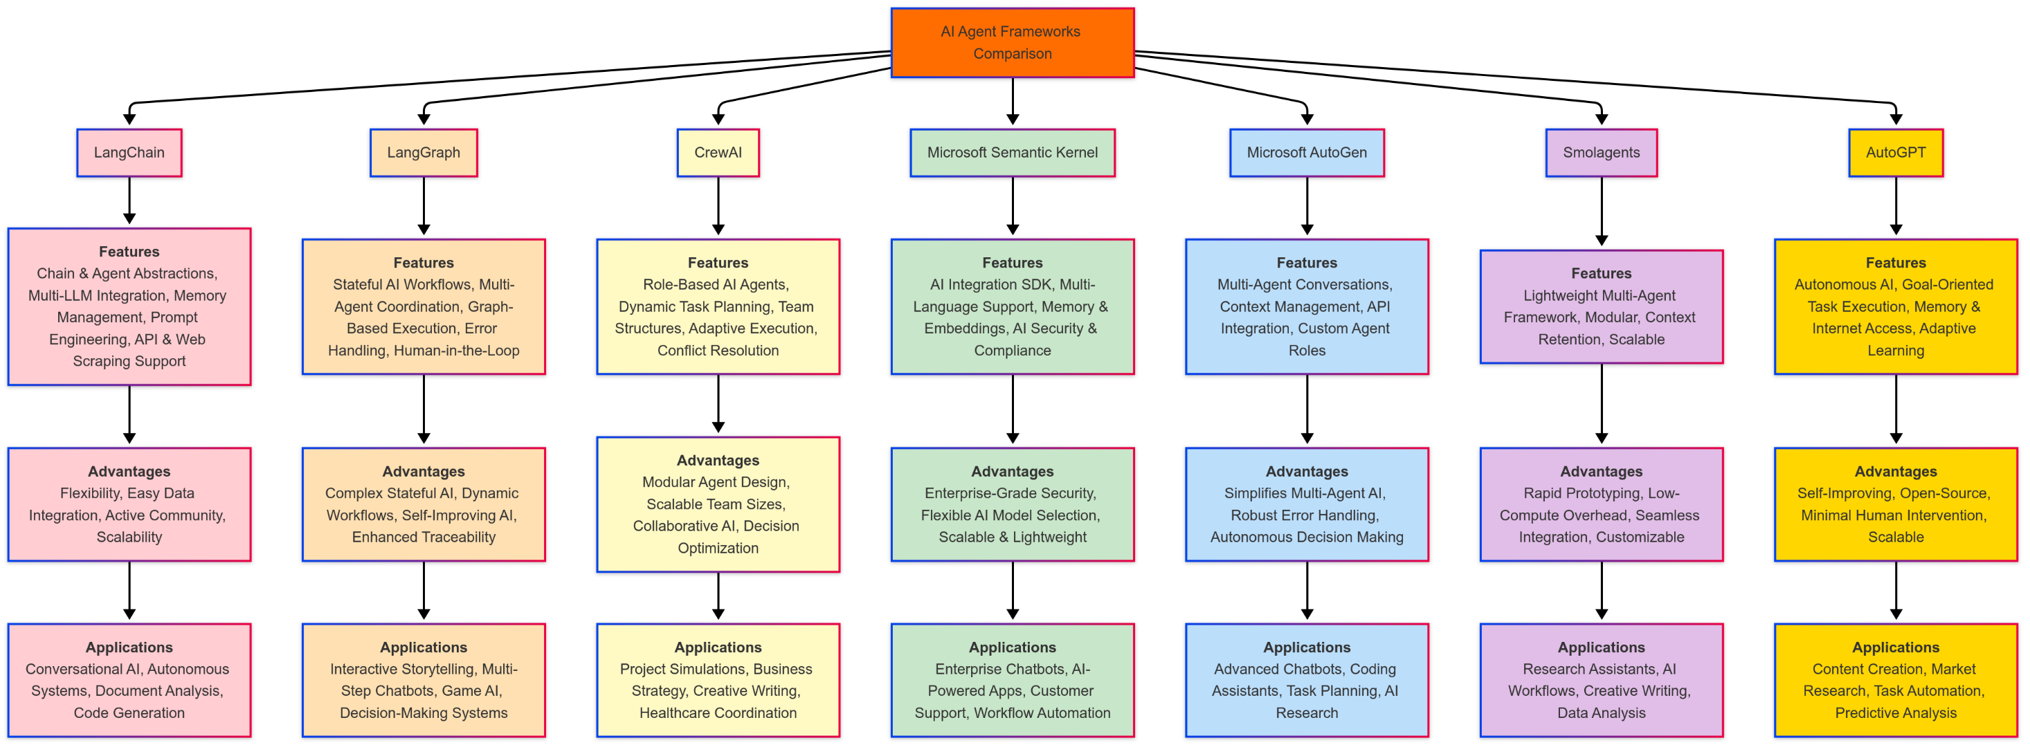

Slide 27
DEMO
Hands-on session

Slide 28
AI Agent Pattern
Agent patterns in AI refer to design approaches that enable AI systems to act more autonomously and intelligently. These patterns, like Reflection, Tool Use, Planning, and Multi-Agent Collaboration, empower AI to reason, plan, execute tasks, and learn from their actions, mimicking human-like problem-solving capabilities.
01
Reflection
Self-critique and improve its own output
02
Tool Use
Call APIs, search, code and databases
03
Planning
Break goals into ordered steps
04
Multi-Agent
Specialised agents collaborate

Slide 29
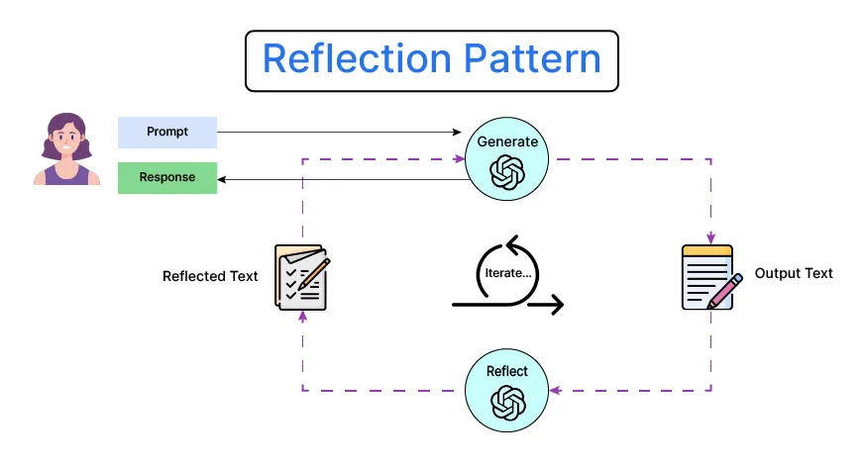
Reflection Pattern
The Reflection Pattern enables an AI agent to pause and evaluate its current progress, strategy, and understanding. It often involves meta-cognition—thinking about what has been done and what needs to be adjusted to reach a goal more efficiently.
Encourages introspection and self-evaluation.
Useful for complex or multi-step tasks.
Helps identify errors and improve reasoning.
Often implemented via checkpoints or "thought loops".
Can be combined with memory modules for deeper reasoning.

Slide 30
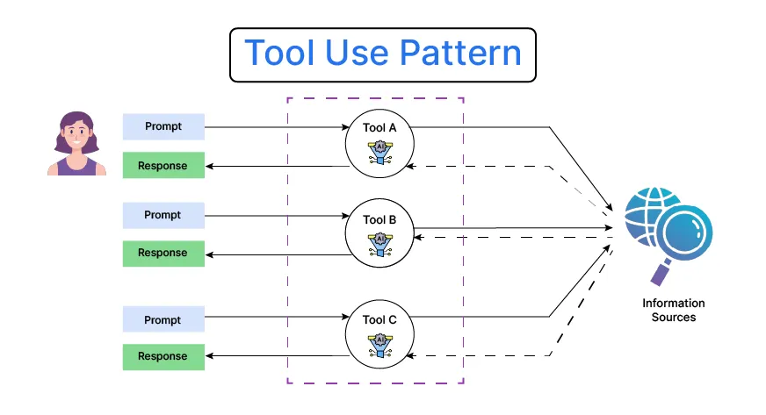
Tool Use Pattern
The Tool Use Pattern allows agents to call upon external APIs, databases, calculators, or plugins to extend their capabilities beyond native reasoning. This empowers agents to handle a wider range of tasks effectively.
Agent invokes tools like search engines, calculators, or code interpreters.
Enables solving tasks beyond language-only capabilities.
Often implemented in frameworks like LangChain or ReAct.
Requires mechanisms for selecting and invoking tools dynamically.
Important for real-world applications like retrieval-augmented generation (RAG).

Slide 31
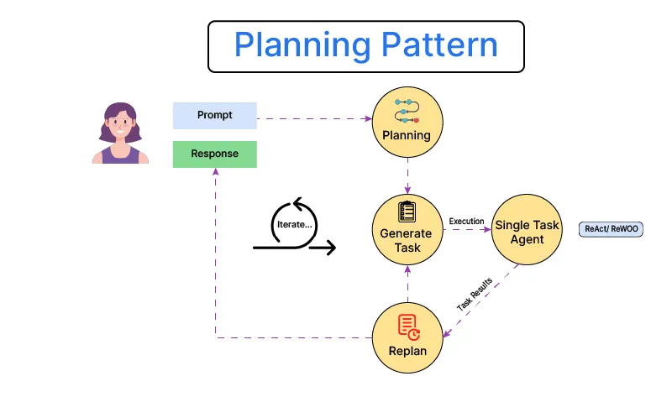
Planning Pattern
The Planning Pattern involves creating a step-by-step plan before executing actions. This structure ensures logical task progression, especially for multi-step or high-stakes tasks requiring accuracy.
Agent outlines goals and subgoals in advance.
Reduces trial-and-error and improves efficiency.
Useful for code generation, reasoning, and long documents.
Often uses a planner-executor model.
Enhances transparency and traceability in agent behavior.

Slide 32
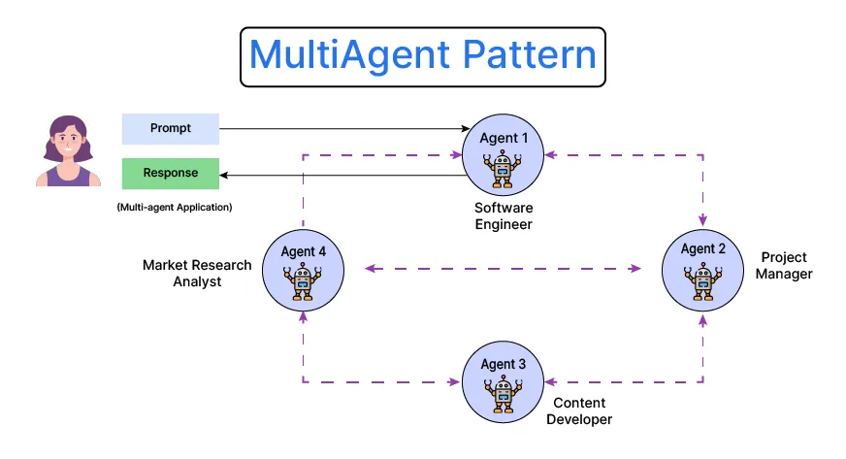
Multi-Agent Pattern
The Multi-Agent Pattern distributes a task across multiple specialized agents, each responsible for a specific role. These agents can collaborate, compete, or coordinate, enabling more scalable and modular solutions.
Supports parallelism and specialization.
Agents can be role-based (e.g., writer, reviewer, executor).
Encourages emergent behavior and coordination.
Ideal for complex tasks like research, code review, or game playing.
Can integrate with human feedback or supervisor agents.

Slide 33
Patterns
Each pattern offers unique strengths for building intelligent systems. Depending on task complexity, environment, and goals, one or more patterns can be combined for optimal performance.
Pattern | Strengths | Best For
Reflection | Improves self-awareness and adaptability | Debugging, strategy adjustment
Tool Use | Extends capabilities via external tools | Math, retrieval, real-world tasks
Planning | Provides structure and foresight | Multi-step reasoning, code generation
Multi-Agent | Enables collaboration and modularity | Complex, distributed task environments

Slide 34
What is agentic AI?
Agentic AI is an artificial intelligence system that can accomplish a specific goal with limited supervision. It consists of AI agents—machine learning models that mimic human decision-making to solve problems in real time. In a multiagent system, each agent performs a specific subtask required to reach the goal and their efforts are coordinated through AI orchestration.
Unlike traditional AI models, which operate within predefined constraints and require human intervention, agentic AI exhibits autonomy, goal-driven behavior and adaptability. The term “agentic” refers to these models’ agency, or, their capacity to act independently and purposefully.
Agentic AI builds on generative AI (gen AI) techniques by using large language models (LLMs) to function in dynamic environments. While generative models focus on creating content based on learned patterns, agentic AI extends this capability by applying generative outputs toward specific goals. A generative AI model like OpenAI’s ChatGPT might produce text, images or code, but an agentic AI system can use that generated content to complete complex tasks autonomously by calling external tools. Agents can, for example, not only tell you the best time to climb Mt. Everest given your work schedule, it can also book you a flight and a hotel.

Slide 35
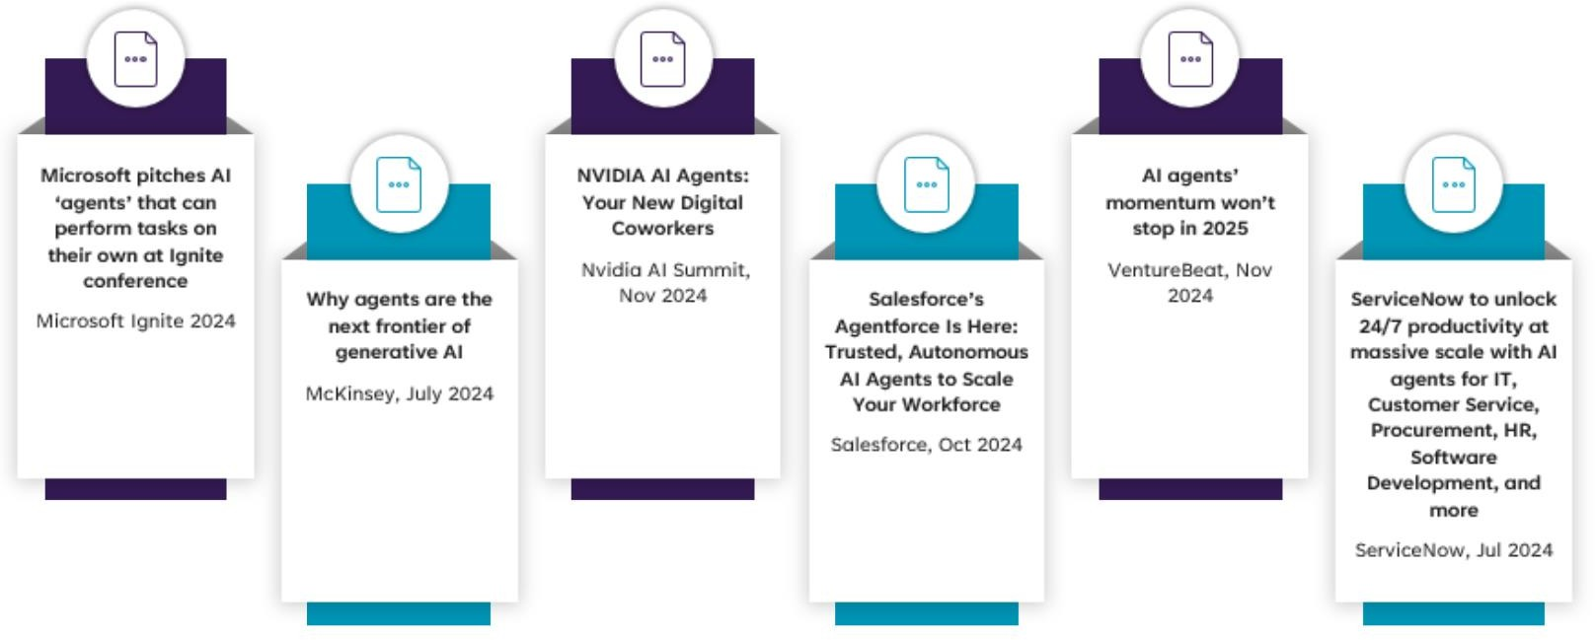
Agentic AI in the News

Slide 36
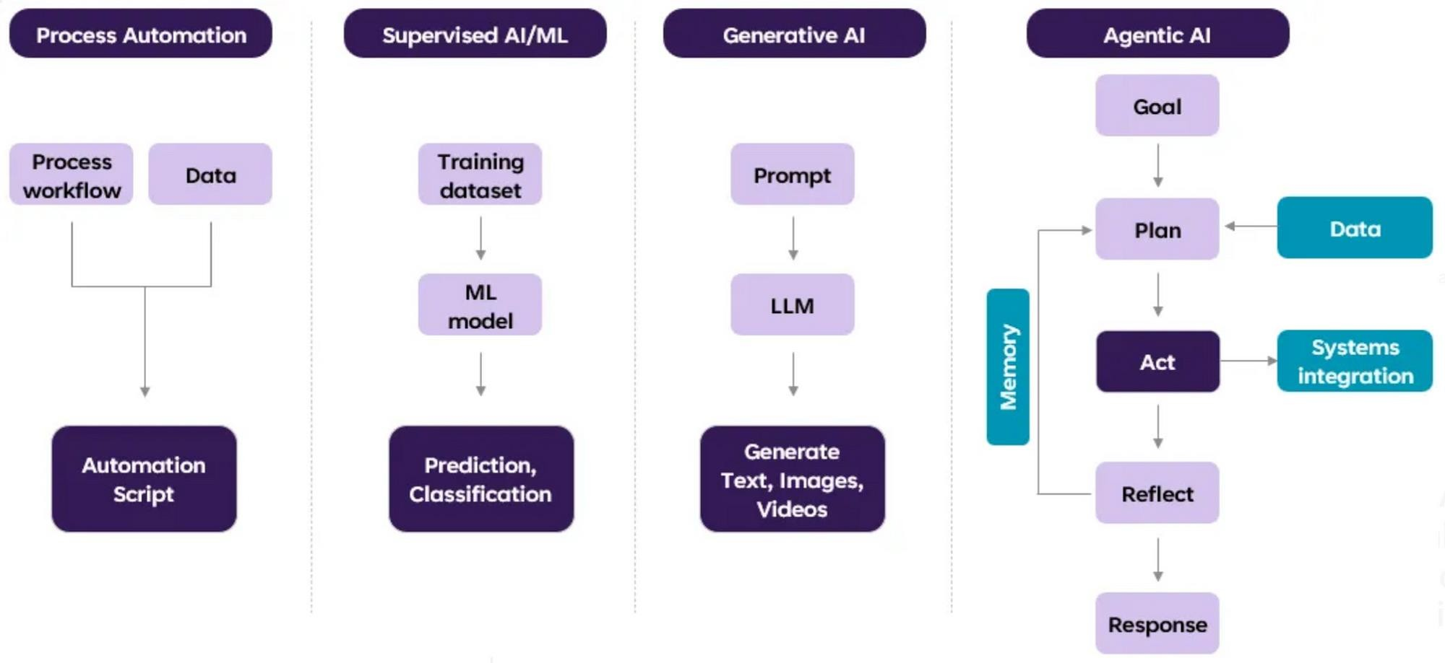
Agentic AI Evolution

Slide 37
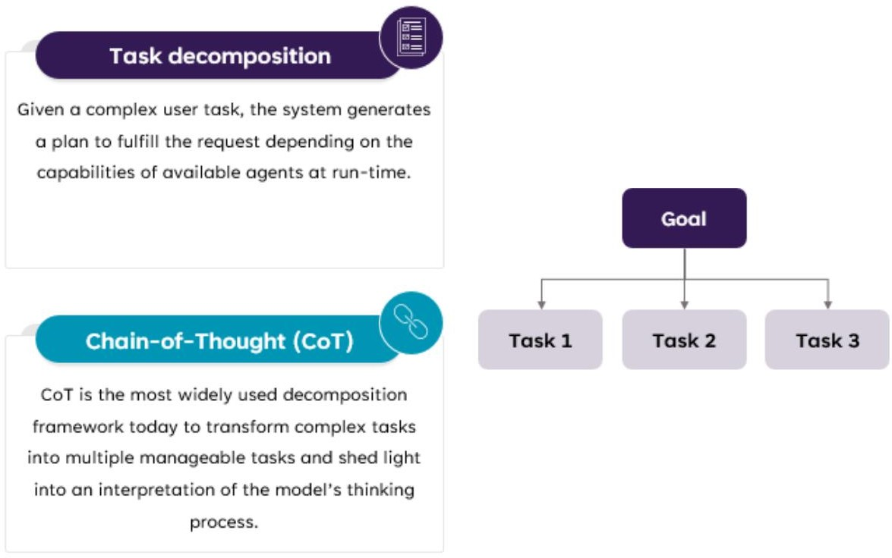
Agentic AI capabilities – Task Decomposition

Slide 38
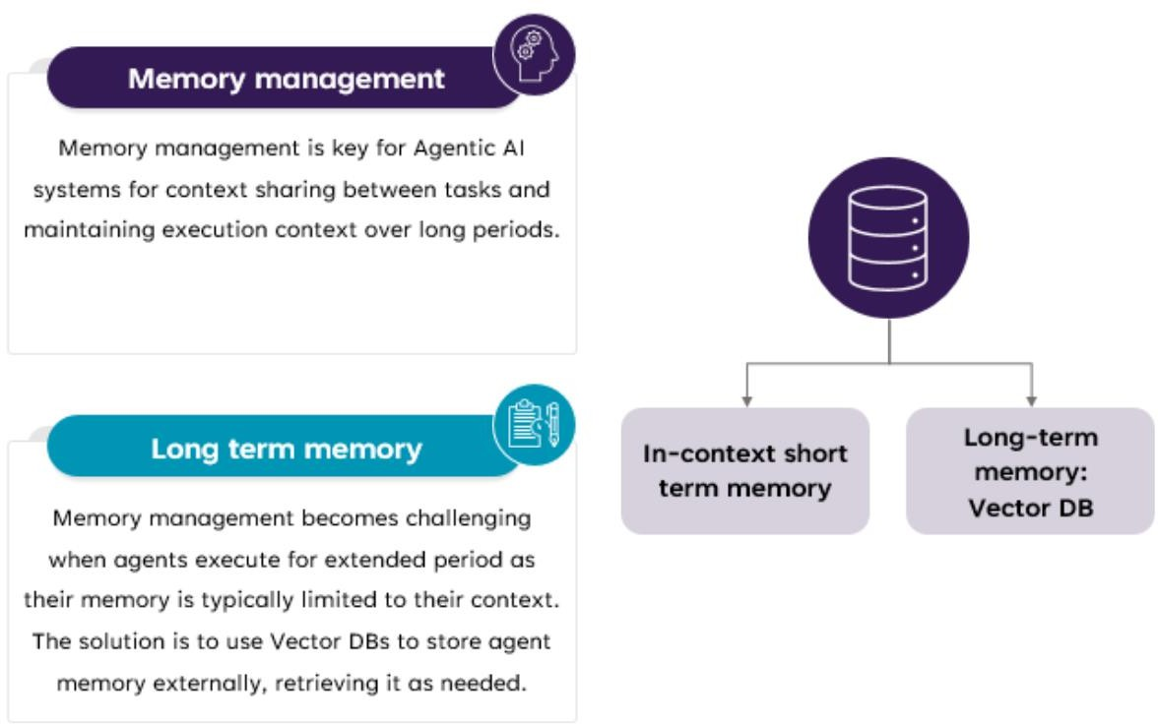
Agentic AI capabilities – Memory Management

Slide 39
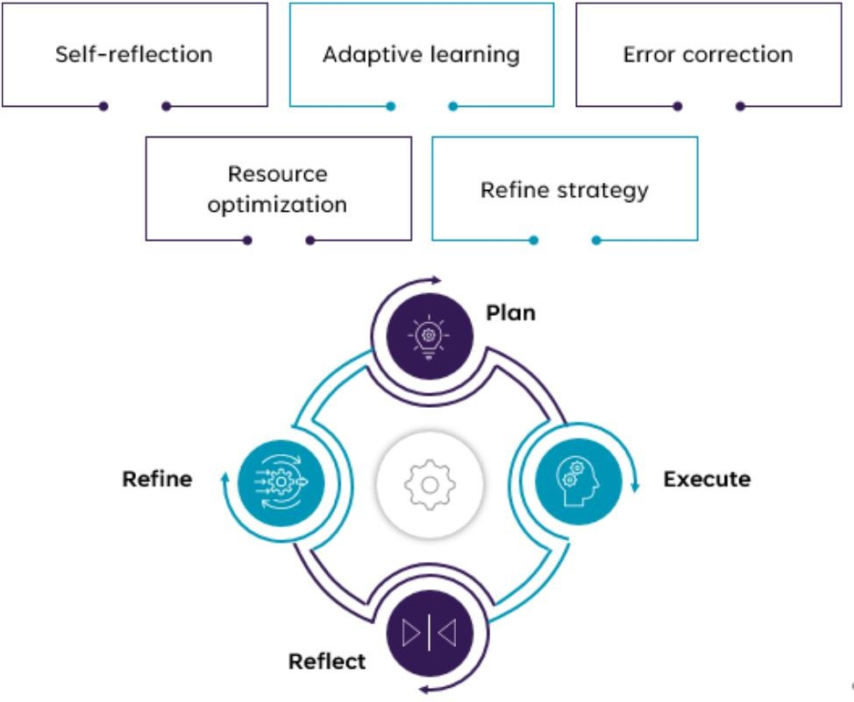
Agentic AI capabilities – Reflect & Adapt

Slide 40
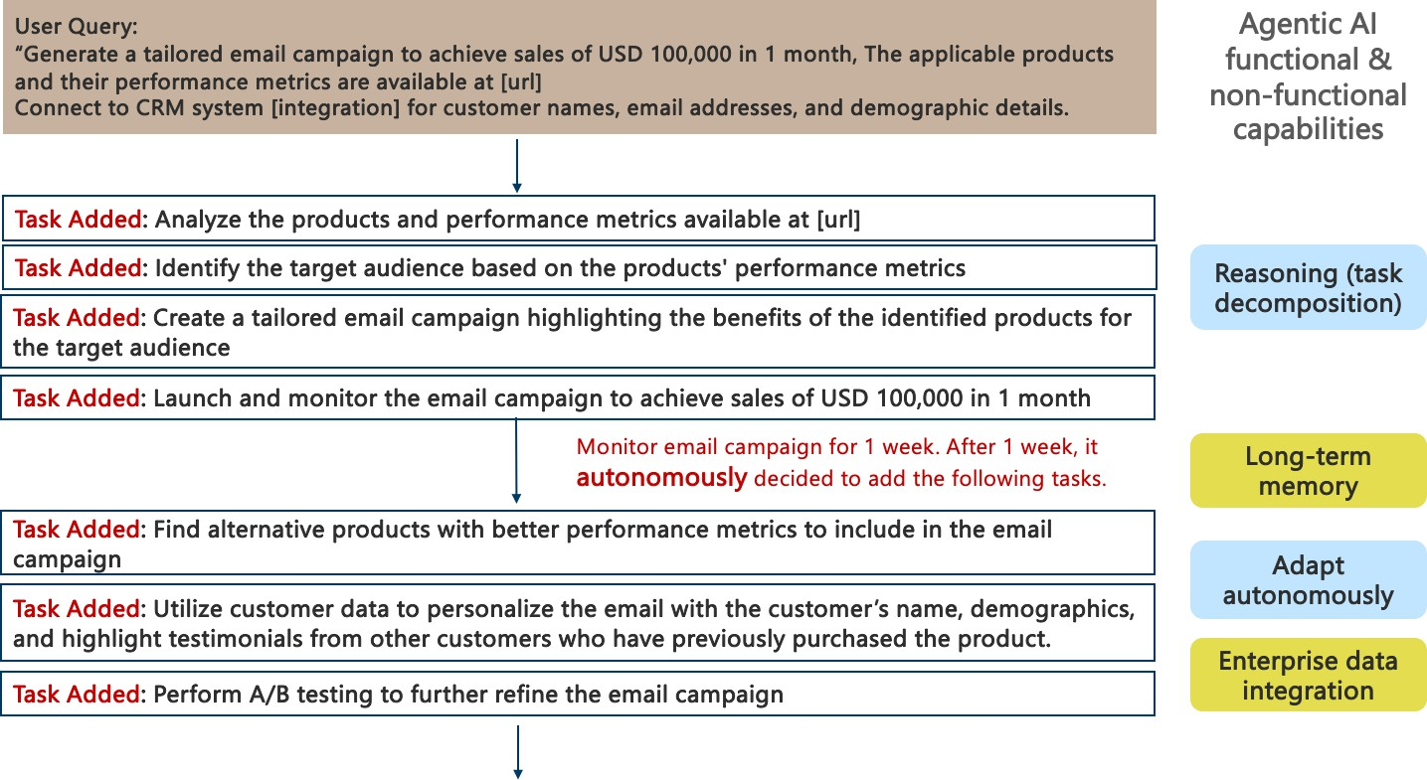
Agentic AI Use-case: Funds Email Marketing Campaign

Slide 41
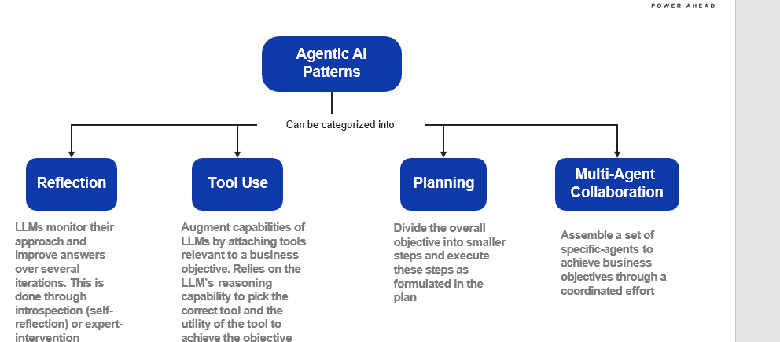
Agentic AI Pattern

Slide 42
Agentic AI Reference Architecture

Slide 43
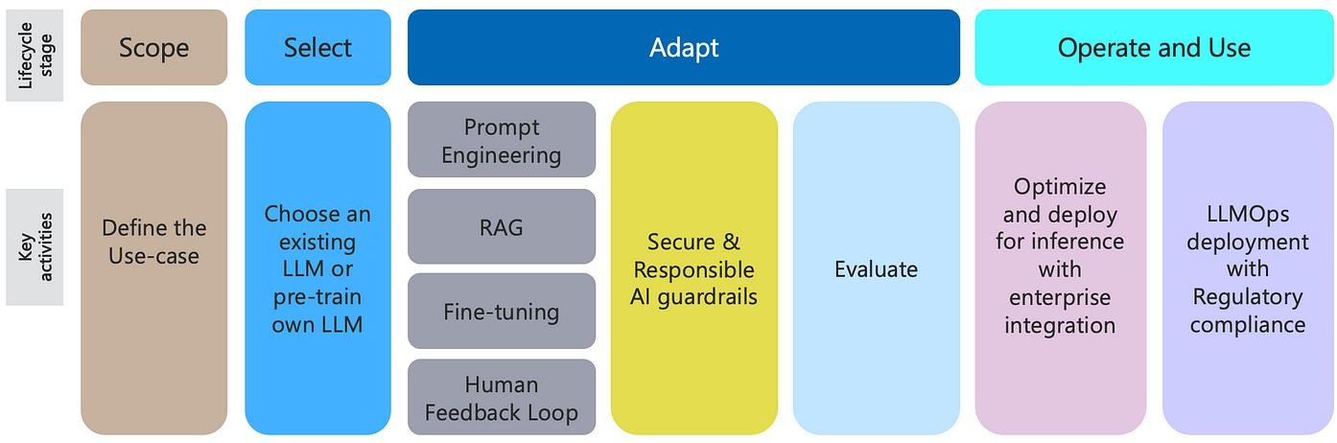
Generative AI Lifecycle

Slide 44
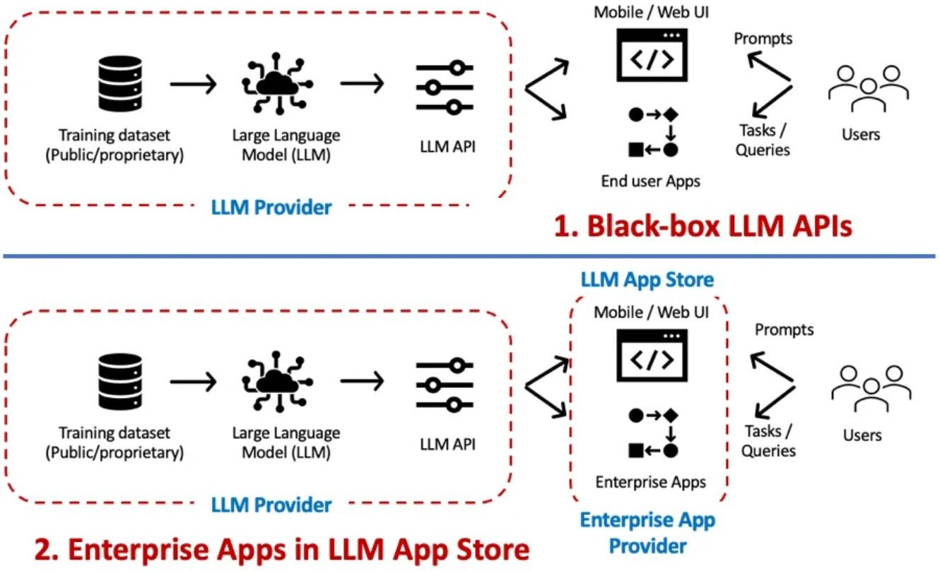
Gen AI Architecture Patterns – APIs & Embedded Gen AI
Black-box LLM APIs: This is the classic ChatGPT example, where we have black- box access to a LLM API/UI. Prompts are the primary interaction mechanism for such scenarios.
While Enterprise LLM Apps have the potential to accelerate LLM adoption by providing an enterprise ready solution; the same caution needs to be exercised as you would do before using a 3rd party ML model — validate LLM/training data ownership, IP, liability clauses.
* D. Biswas. Generative AI – LLMOps Architecture
Patterns. Data Driven Investor, 2023 ( link)

Slide 45
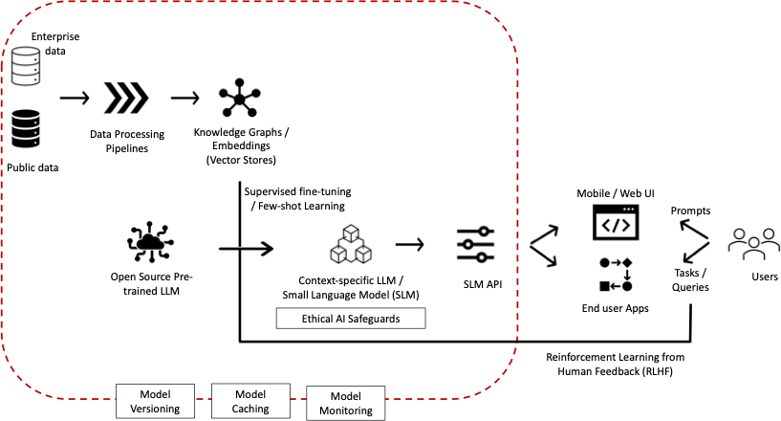
Gen AI Architecture Patterns – Fine-tuning
LLMs are generic in nature. To realize the full potential of LLMs for Enterprises, they need to be contextualized with enterprise knowledge captured in terms of documents, wikis, business processes, etc.
This is achieved by fine-tuning a LLM with enterprise knowledge / embeddings to develop a context- specific LLM.

Slide 46
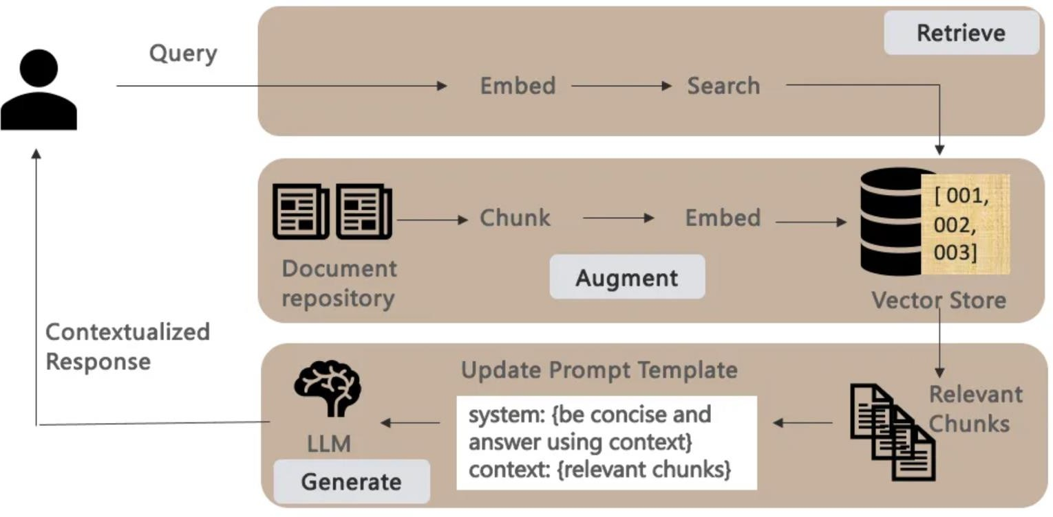
Gen AI Architecture Patterns – RAG
Fine-tuning is a computationally intensive process. RAG provides a viable alternative by providing additional context with the prompts — grounding the retrieval / responses to the given context.
Given a user query, a RAG pipeline literally consists of
the 3 phases below:
Retrieve: Transform user queries to embeddings to
compare its similarity score with other content.
Augment: with search results / context retrieved from a vector store that is kept current and in sync with the underlying document repository.
Generate: contextualized responses by making
retrieved chunks part of the prompt template that provides additional context to the LLM on how to answer the query.

Slide 47
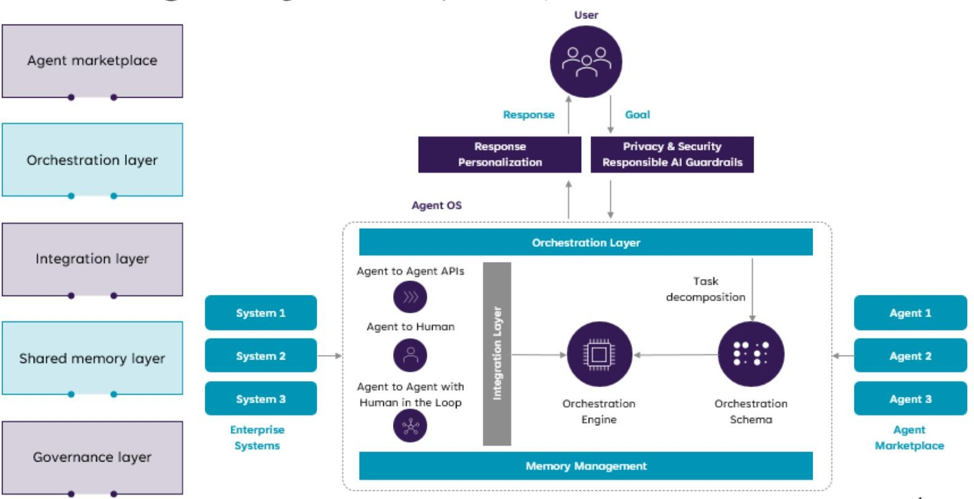
Agentic AI Platform Reference Architecture
The future where enterprises will be able to develop new Enterprise AI Apps by orchestrating / composing multiple existing AI Agents.
* D. Biswas. Stateful Monitoring and Responsible Deployment of AI Agents. 17th International Conference on Agents and Artificial Intelligence (ICAART), 2025 ( link)

Slide 48
AI Agents Marketplace & Discovery for Multi- agent Systems

Slide 49
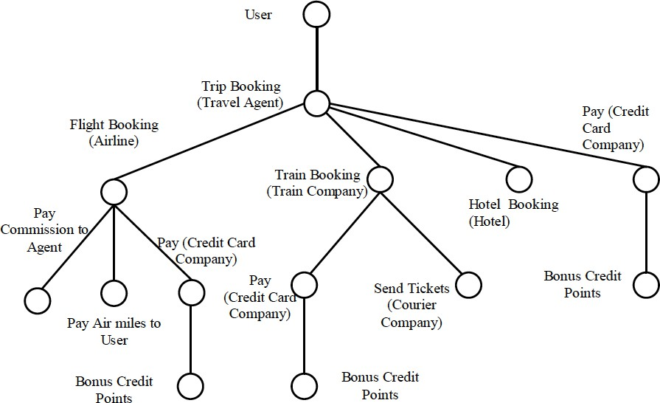
(Complex) Agentic AI Task Decomposition
A high-level approach to solving complex tasks:
- decomposition of the given complex task into a hierarchy or workflow of) simple tasks,
followed by
- composition of agents able to execute the simpler tasks.
This can be achieved in a dynamic or static manner.
Dynamic: given a complex user task, the system comes up with a plan to fulfil the request depending on the capabilities of available agents at run-time.
Static: given a set of agents, composite agents
are defined manually at design-time combining their capabilities.

Slide 50
Agentic AI Scenarios:
Agentic RAGs
Reinforcement Learning Agents

Slide 51
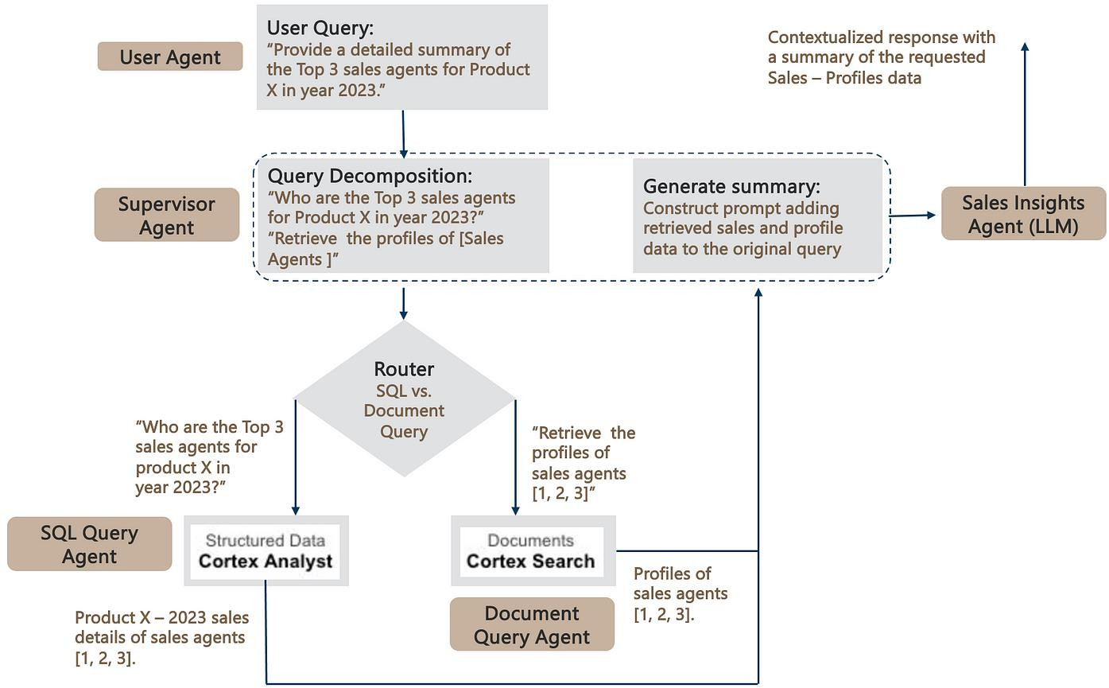
Agentic RAGs: extending RAGs to SQL Databases
Agentic AI framework to build RAG pipelines that work seamlessly over both structured and unstructured data stored in Snowflake.
The SQL & Document query agents leverage the respective Snowflake Cortex Analyst and Search components detailed earlier to query the underlying SQL and Document repositories.
Finally, to complete the RAG pipeline, the retrieved data is added to the original prompt — leading the generation of a contextualized response.
* D. Biswas. Agentic RAGs: extending RAGs to SQL Databases. AI Advances, 2024 (link)

Slide 52
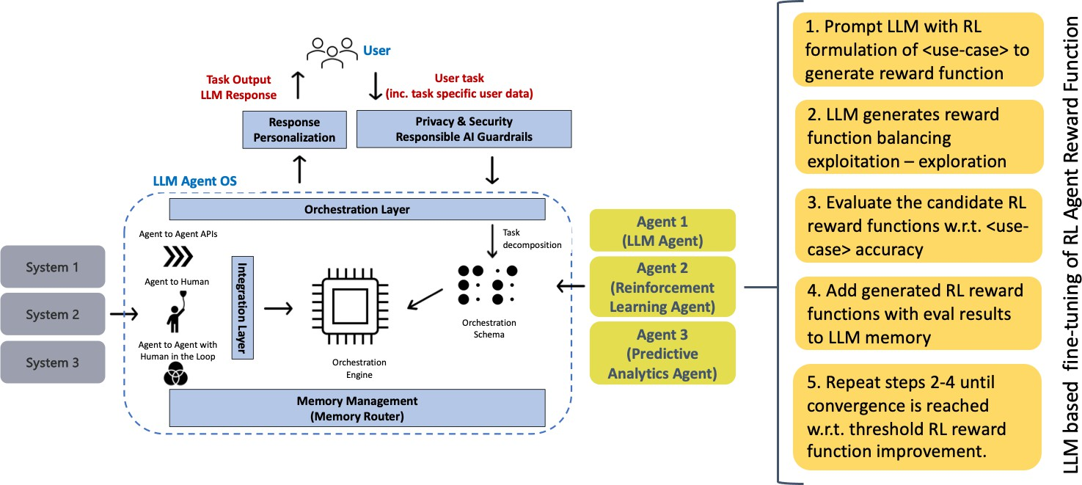
Reinforcement Learning Agents
When we talk about AI agents today, we mostly talk about LLM agents, which loosely translates to invoking (prompting) an LLM to perform natural language processing (NLP) tasks
Some agentic tasks might be better suited to other ML techniques, e.g., Reinforcement Learning (RL), predictive analytics, etc. — depending on the use-case objectives.
* D. Biswas. LLM based fine-tuning of Reinforcement Learning Agents. AI Advances, 2024 (link)

Slide 53
DEMO
Hands-on session

